Slide 1
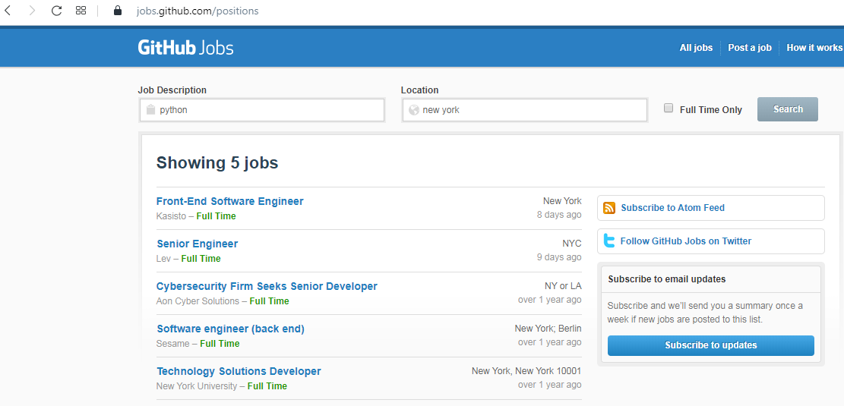



How to use an API?
Client
Request
Response

Slide 2
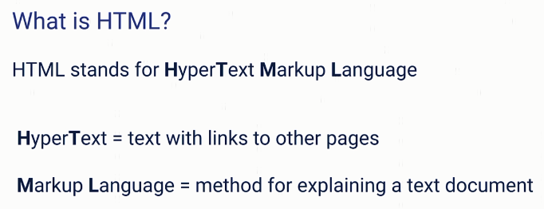
How to use an API?

Slide 3
How to use an API?
https://jobs.github.com/positions?description=python&location=new+york
https://jobs.github.com/positions.json?description=python&location=new+york

